Slide 1
Enhancing 3D Point Cloud Classification with Measure-Theoretic Features: Integrating Product Coefficients into LiDAR Analysis
Enhancing 3D Point Cloud Classification with Measure- Theoretic Features: Integrating Product Coefficients into LiDAR Analysis
Patricia Medina, Ph.D. Mathematical Sciences Department New York City College of Technology
Brooklyn, NY 11201
PMedina@citytech.cuny.edu Ninth International Conference on Data Management, Analytics and Innovation– ICDMAI 2025, Kolkata, India
January 18th, 2025

Slide 2
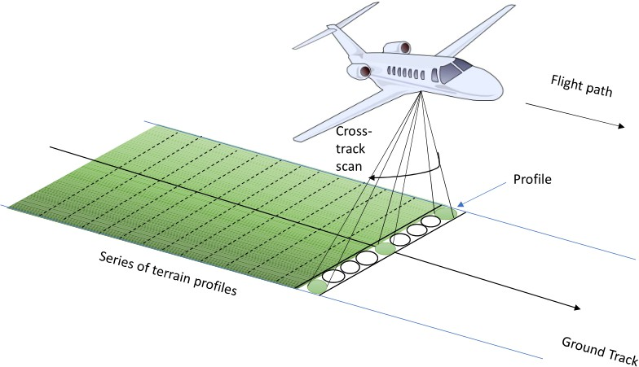
Introduction: The data
Enhancing 3D Point Cloud Classification with Measure- Theoretic Features: Integrating Product Coefficients into LiDAR Analysis
What is LiDAR?
LiDAR stands for light detection and ranging and it is an optical remote sensing technique
that uses laser light to densely sample the surface of the earth, producing highly accurate x, y and z measurements. The collection vehicle of LiDAR data might be and aircraft, helicopter, vehicle, and tripod.
Figure: The profile belonging to a series of terrain profiles is measured in the cross track direction of an airborne platform.

Slide 3
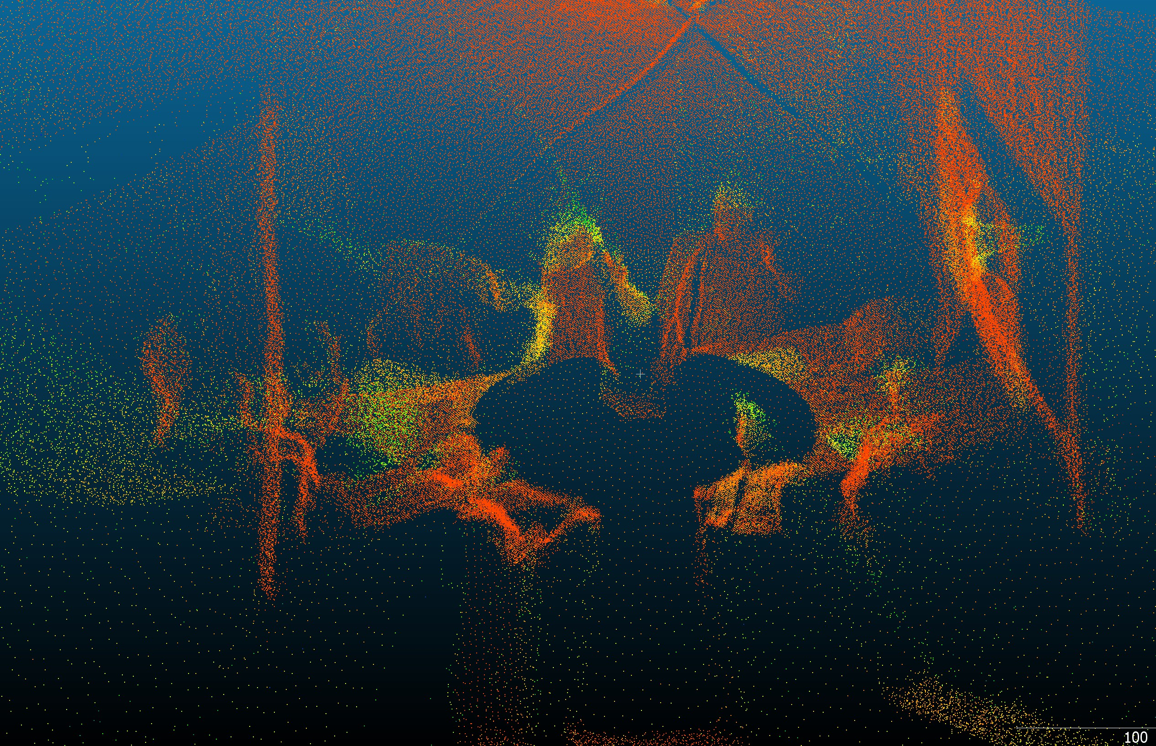
Using a LiDAR Tripod at UW (eScience Institute) with my team at Geohack week, 2018
Enhancing 3D Point Cloud Classification with Measure- Theoretic Features: Integrating Product Coefficients into LiDAR Analysis

Slide 4
Outline
Enhancing 3D Point Cloud Classification with Measure- Theoretic Features: Integrating Product Coefficients into LiDAR Analysis
We address the enhancement of classification accuracy for 3D point cloud Lidar data, an optical remote sensing technique that estimates the three-dimensional coordinates of a given terrain.
Our approach introduces product coefficients, theoretical quantities derived from measure theory, as additional features in the classification process.
We define and present the formulation of these product coefficients and conduct a comparative study, using them alongside principal component analysis (PCA) as feature inputs.
Results demonstrate that incorporating product coefficients into the feature set significantly improves classification accuracy within this new framework.

Slide 5
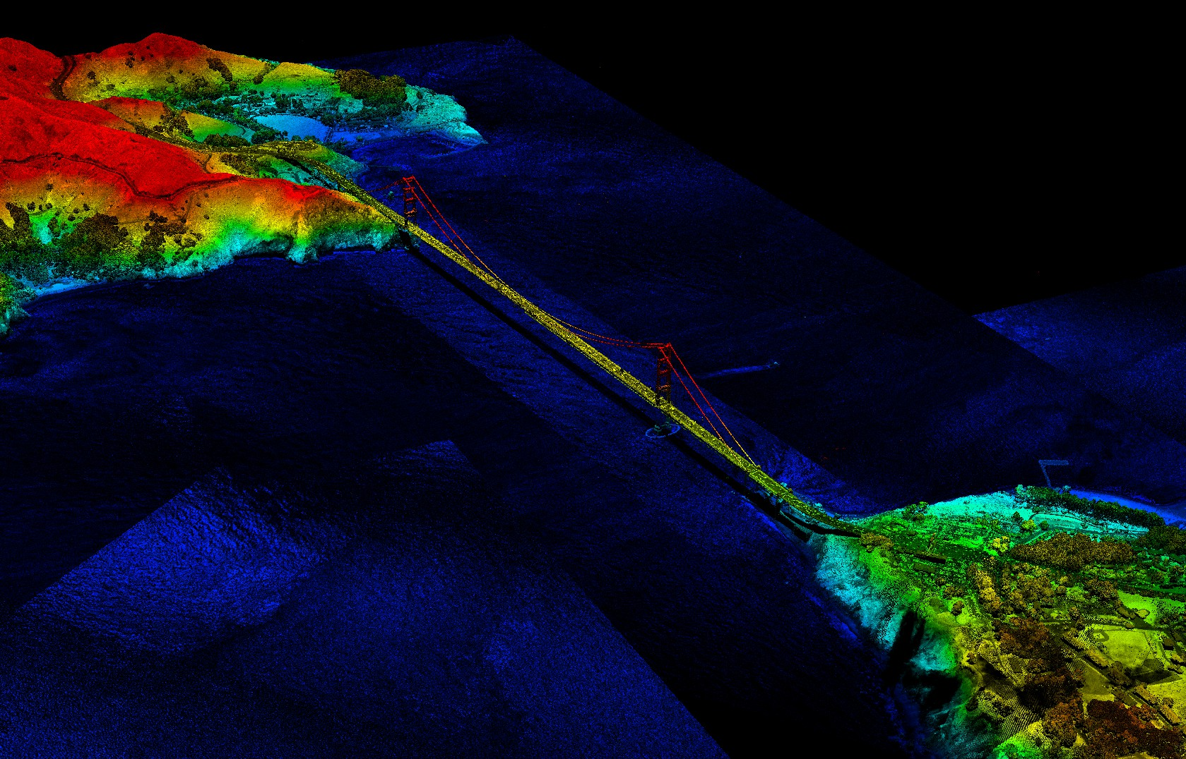
3D point cloud LiDAR Data
Enhancing 3D Point Cloud Classification with Measure- Theoretic Features: Integrating Product Coefficients into LiDAR Analysis
Figure: 3D LiDAR Point Cloud Image of San Francisco Bay and Golden Gate Bridge in California, Courtesy of Jason Stoker, USGS
Goal:
To classify classes such as ground, water, and the bridge structure.

Slide 6
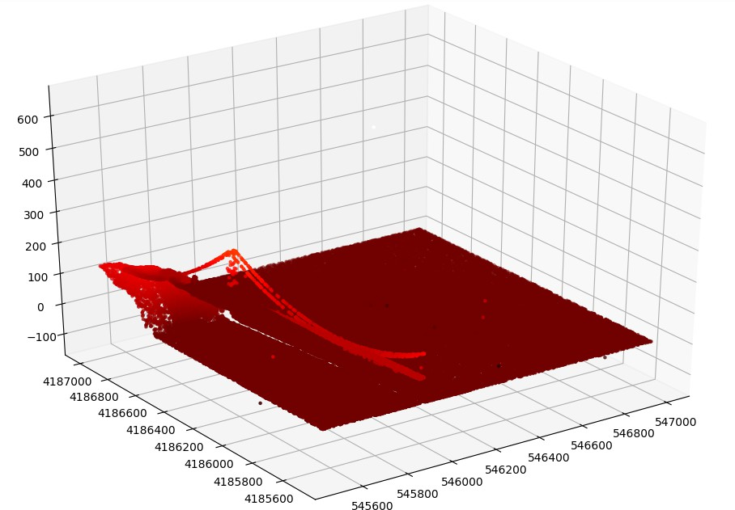
Scatter plot. About 15 million data points
Enhancing 3D Point Cloud Classification with Measure- Theoretic Features: Integrating Product Coefficients into LiDAR Analysis

Slide 7
Attributes
Intensity. Captured by the LiDAR sensors is the intensity of each return.
Return number. An emitted laser pulse can have up to five returns depending on the features it is reflected from.
Number of returns. The number of returns is the total number of returns for a given pulse.
Point classification. Every LiDAR point that is post-processed can have a classification that defines the type of object that has reflected the laser pulse. The different classes are defined using numeric integer codes in the LAS files.
Edge of flight line. Points flagged at the edge of the flight line will be given a value of 1, and all other points will be given a value of 0.
RGB. LiDAR data can be attributed with RGB (red, green, and blue) bands.
GPS time. The GPS time stamp at which the laser point was emitted from the aircraft. The time is in GPS seconds of the week.
Scan angle. The scan angle is a value in degrees between -90 and +90.
Scan direction. The scan direction is the direction the laser scanning mirror was traveling at the time of the output laser pulse.
Enhancing 3D Point Cloud Classification with Measure- Theoretic Features: Integrating Product Coefficients into LiDAR Analysis

Slide 8

Attribute example: Number of Returns
Enhancing 3D Point Cloud Classification with Measure- Theoretic Features: Integrating Product Coefficients into LiDAR Analysis
Amplitude
1st return 2nd return
Time
3rd return
4th return
5th return
Figure: A pulse can be reflected off a tree’s trunk, branches, and foliage as well as reflected off the ground. Karamatou Yacoubou Djima, F. Patricia Medina, Linda Ness and Melanie Weber, Heuristic Framework for Multi-Scale Testing of the Multi-Manifold Hypothesis , Accepted, AWM Springer Series.

Slide 9
Classification meaning and value
Enhancing 3D Point Cloud Classification with Measure- Theoretic Features: Integrating Product Coefficients into LiDAR Analysis
Classification value | Meaning
0 | Never classified
1 | Unassigned
2 | Ground
3 | Low Vegetation
4 | Medium Vegetation
5 | High Vegetation
6 | Building
7 | Low Point
8 | Reserved
9 | Water

Slide 10
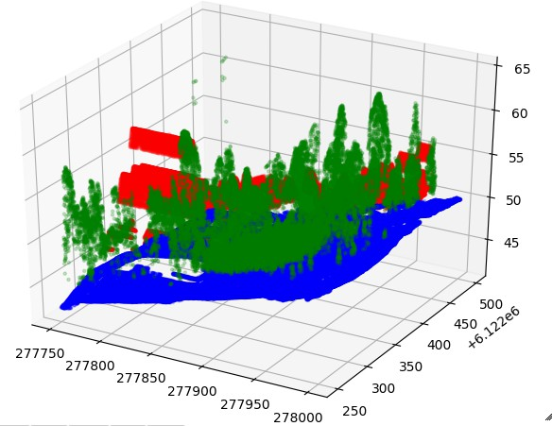
The Data
Enhancing 3D Point Cloud Classification with Measure- Theoretic Features: Integrating Product Coefficients into LiDAR Analysis
Figure: Python plot representing LiDAR point cloud of a neighborhood in Australia (about 270,000 points). Exact coordinates are available. Just three classes for now.

Slide 11
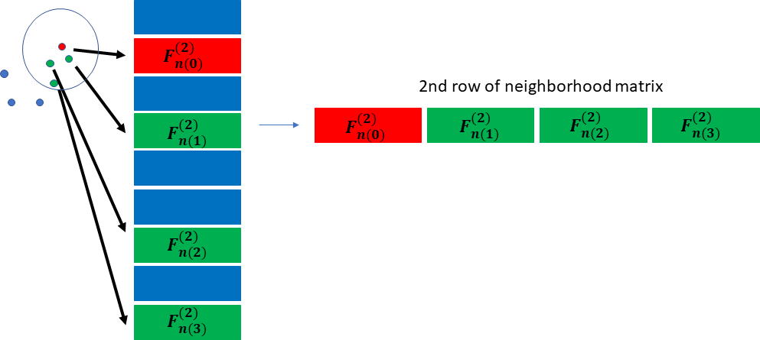
One way we did feature engineering before. [F. P. Medina and
R. Paffenroth, “Classification frameworks comparison on 3D point clouds”, 2021 IEEE High Performance Extreme
Computing Conference (HPEC), Waltham, MA, USA, 2021, pp. 1-6]
We illustrate how to obtain the second row of the neighbor matrix in Fig. 5.
Enhancing 3D Point Cloud Classification with Measure- Theoretic Features: Integrating Product Coefficients into LiDAR Analysis
Figure: Forming the second row by concatenating the features of of the 3 nearest neighbors to the the second example in the original data frame. The neighbors are computed respect to the spatial coordinates (x, y, z) of the design point. Observe that if the original data has N = 7 features, the neighbor matrix has (3 + 1) × 7 = 28 features.

Slide 12
Another idea to do feature engineering before applying typical ML algorithm
Enhancing 3D Point Cloud Classification with Measure- Theoretic Features: Integrating Product Coefficients into LiDAR Analysis
The original features include: x, y, z,, intensity, RGB, number of returns and and we can add new features (feature engineering)
We store the vector containing the classification given by the software (e.g. LASTool)
Choose 80% for testing and 20% for training:
Xtrain
← 80%
Xtest
← 20%
We also store actual classification value y and prediction yˆ
We can use product coefficients to generate new features from the original data

Slide 13
An example of a general ML classification framework
Feature engineering
Perform dimensionality reduction using either PCA (for a linear projection) or a 3-layer auto-encoder (for a non-linear projection)
If using PCA, then use the projected features as the predictors for our learning
If using an auto-encoder, then use the hidden layer as the predictors for our learning
Classifier: K-nearest neighbor, random forest, feed-forward neural network
Cross-validation (f1 scores)
Enhancing 3D Point Cloud Classification with Measure- Theoretic Features: Integrating Product Coefficients into LiDAR Analysis

Slide 14
The metric that we use to measure precision of our algorithm is given by
Enhancing 3D Point Cloud Classification with Measure- Theoretic Features: Integrating Product Coefficients into LiDAR Analysis
∑N
TP
PRE =
j=1
j
(1)
micro
N
FP ,
∑ TP + ∑^{N}
j j
j=1 j=1
(known as micro average) where TP_{i} means true positive on the
ith class and FP_{i} means false positive on the ith class. We provide the
_{F1 score = 2} PRE_{micro} · Recall ,
PRE_{micro} + Recall
where the recall (or sensitivity) is given by
(2)
∑N
TP_{j}
Recall = ^{j=1} ,
(3)
∑N
TP_{j} + ∑^{N} FN_{j}
j=1 j=1
where FN_{j} means false negative on the jth class.

Slide 15
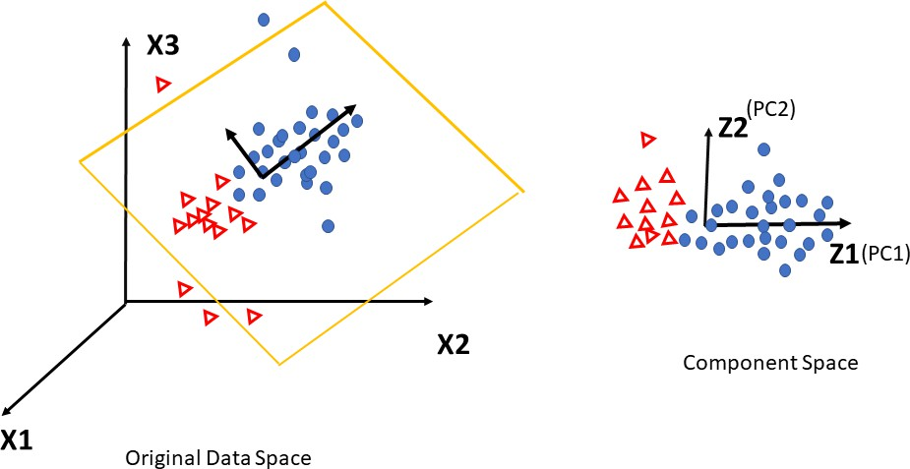
Dimensionality reduction: PCA
The low dimensional data representation is obtained by mapping the data via M, i.e.
Z = XM.
PCA solves the eigen-problem cov(X)M = λ M.
cov(X): sample covariance matrix of X. The principal components φ₁, φ₂,..., φ_{d} are the ordered sequence of eigenvectors of cov(X), and the variances of the components are the eigenvalues.
M is the matrix with columns φi, i = 1, . . . d.
Enhancing 3D Point Cloud Classification with Measure- Theoretic Features: Integrating Product Coefficients into LiDAR Analysis
Figure: Z₁ = φ₁₁X₁ + φ₂₁X₂ + φ₃₁X₃ and Z₂ = φ₁₂X₁ + φ₂₂X₂ + φ₃₂X₃

Slide 16
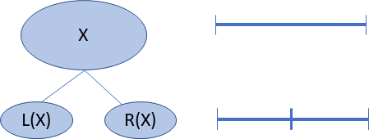
Feature engineering with product coefficients
Enhancing 3D Point Cloud Classification with Measure- Theoretic Features: Integrating Product Coefficients into LiDAR Analysis
µ be a dyadic measure on a dyadic set X and S be a subset of X. The product coefficient parameter a_{S} is the solution for the following system of equations
1
µ(L(S)) = (1 + as)µ(S) (4)
2
µ(R(S)) = ¹ (1 −as)µ(S) (5)
µ: non-negative measure on X; dy: the naive measure, such that dy(X) = 1
2
Dyadic Product Formula Representation
X with binary set system B whose non-leaf sets are Bn
dy(L(S)) = ¹ dy(S), dy(R(S)) = ¹ dy(S)
2 2
µ is additive in the binary set system,
µ = µ(X) ∏_{S∈Bn} (1 + a_{S}h_{S} ) dy
where a_{S} ∈ [−1, 1]
h_{S} : Haar-like function
R. FEFFERMAN, C. KENIG, AND J. PIPHER, The theory of weights and the Dirichlet problem for elliptical equations, Annals of Math., 134 (1991), pp. 65–124

Slide 17
Lemma 1 (Dyadic Product Formula Representation)
Enhancing 3D Point Cloud Classification with Measure- Theoretic Features: Integrating Product Coefficients into LiDAR Analysis
Let X be a dyadic set with binary set system B whose non-leaf sets are Bn.
1 A non-negative measure µ on X has a unique product formula representation
µ = µ(X) ∏ (1 + a_{S}h_{S} ) dy
(6)
S∈Bn
where a_{S} ∈ [−1, 1] and a_{S} is the product coefficient for S.
Any assignment of parameters a_{S} for (−1, 1) and choice of µ(X) > 0 determines a measure µ which is positive on all sets S on B with product formula
µ = µ(X) ∏_{S∈Bn} (1 + a_{S}h_{S} ) dy whose product coefficients are the parameters a_{S}.
Any assignment of parameters a_{S} from [−1, 1] and choice of µ(X) > 0 determines a non-negative measure µ with product formula µ = µ(X) ∏_{S∈Bn} (1 + a_{S}h_{S} ) dy. The parameters are the product coefficients if they satisfy the constraints:
If a_{S} = 1, then the product coefficient for the tree rooted at R(S) equals 0. If a_{S} = −1, then the product coefficient for the tree rooted at L(S) equals 0.
1
2

Slide 18
Example 2 (Formula for a scale 0 dyadic measure)
Enhancing 3D Point Cloud Classification with Measure- Theoretic Features: Integrating Product Coefficients into LiDAR Analysis
Let X = [0, 1] and let there be a non-negative measure µ such that
µ(X) = 1, µ(L(X)) = ¹ and µ(R(X)) = ³ . Let a = a_{X} be the product
4 4
coefficient which is the solution for the system of equations
1
µ(L(X)) = ₂ (1 + a)µ(X)
(7)
µ(R(X)) = ¹ (1 −a)µ(X).
(8)
2
1
Subtracting (8) from (7) we obtain a = ^{µ(L(X)) − µ(R(X))} = − .
µ(X) 2
Since, dy(X) = 1 and dy(L(X)) = ¹ = dy(R(X)) then by the product
2
formula form,
µ = µ(X)(1 + ah)dy,
(9)
where h is the Haar-like function with S = X.

Slide 19
Past work (another Lidar dataset)
Enhancing 3D Point Cloud Classification with Measure- Theoretic Features: Integrating Product Coefficients into LiDAR Analysis
Applying the product formula representation to a counting measure derived from a set of LIDAR sample data (*). This data consists of ten sets of discrete points in
3-dimensional space, representing the surfaces visible to the scanning laser
rangefinder in ten nearby scenes. Each point has been labeled as either “vegetation” or “ground”.
Previous work had examined this same data using a multi-scale SVD approach to build a support vector machine (SVM) based classification rule that could, with high accuracy, reproduce the vegetation/ground labeling. Herein, product coefficient parameters are used as features instead of multi-scale SVD parameters.
The experiment showed that decision rules for distinguishing two measures (here “vegetation and “ground”) could be approximately inferred from histograms of the product coefficients. While the metrics were not as good as for multi-scale SVD, the method did provide a transparent rationale for the decision rule.
(*) Brodu, N., & Lague, D., 3D terrestrial LiDAR data classication of complex natural scenes using a multi-scale dimensionality criterion: applications in geomorphology, ISPRS Journal of Photogrammetry and Remote Sensing, vol. 16, pp. 121-134, 2012.

Slide 20
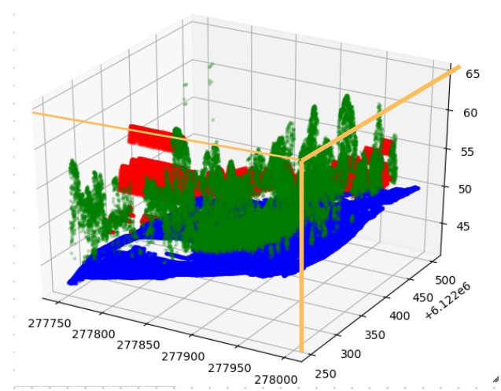
How to compute product coefficients for Lidar?
Enhancing 3D Point Cloud Classification with Measure- Theoretic Features: Integrating Product Coefficients into LiDAR Analysis
Put the 3D point cloud in the unit cube and use the counting measure...

Slide 21
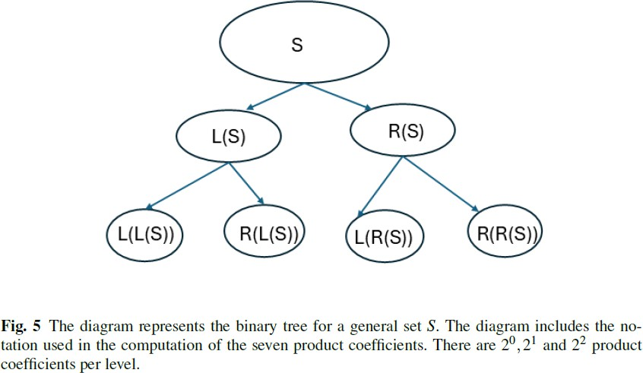
Binary tree
Enhancing 3D Point Cloud Classification with Measure- Theoretic Features: Integrating Product Coefficients into LiDAR Analysis

Slide 22
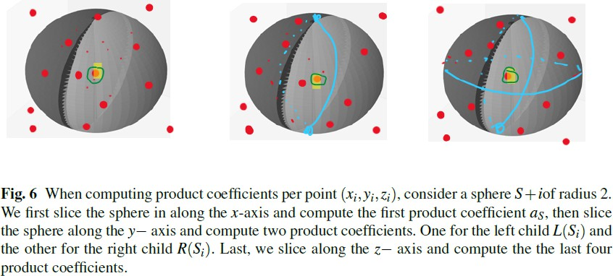
Computing product coefficients on points inside spheres
Enhancing 3D Point Cloud Classification with Measure- Theoretic Features: Integrating Product Coefficients into LiDAR Analysis

Slide 23
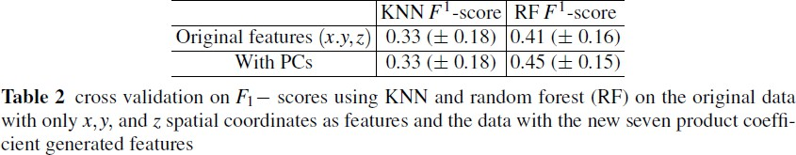
F1 scores: Original data vs. Adding product coefficients
Enhancing 3D Point Cloud Classification with Measure- Theoretic Features: Integrating Product Coefficients into LiDAR Analysis

Slide 24
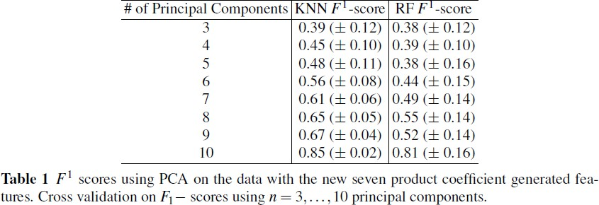
F1 scores: Performing PCA after adding product coefficient features
Enhancing 3D Point Cloud Classification with Measure- Theoretic Features: Integrating Product Coefficients into LiDAR Analysis

Slide 25
Future Directions
Enhancing 3D Point Cloud Classification with Measure- Theoretic Features: Integrating Product Coefficients into LiDAR Analysis
considering more physical features from the original Lidar and computing product coefficients on neighborhood sets of dimension n ≥ 3.
considering bigger size data sets to test the robustness of this new framework.
engineering more features by computing intrisic dimension for example of the dataset and perform more comparison experiments.
performing dimensionality reduction with an auto-encoder and comparing this new framework with the one including PCA.
studying other covariance reduction techniques and compare with PCA performance.

Slide 26
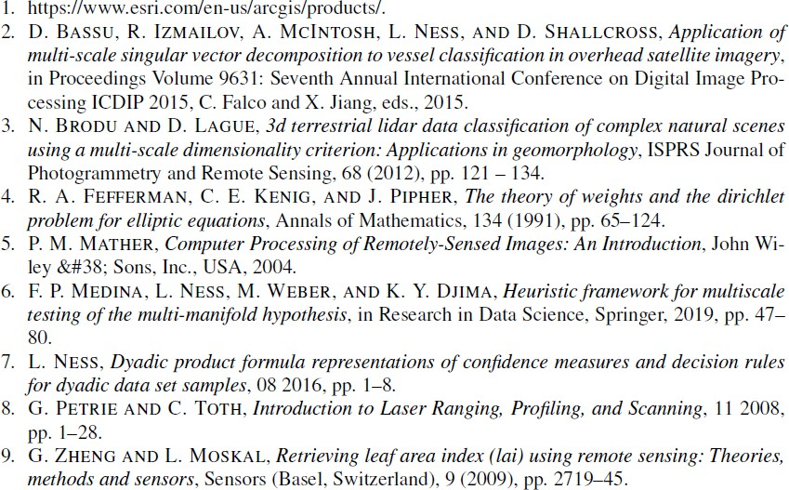
References
Enhancing 3D Point Cloud Classification with Measure- Theoretic Features: Integrating Product Coefficients into LiDAR Analysis

Slide 27
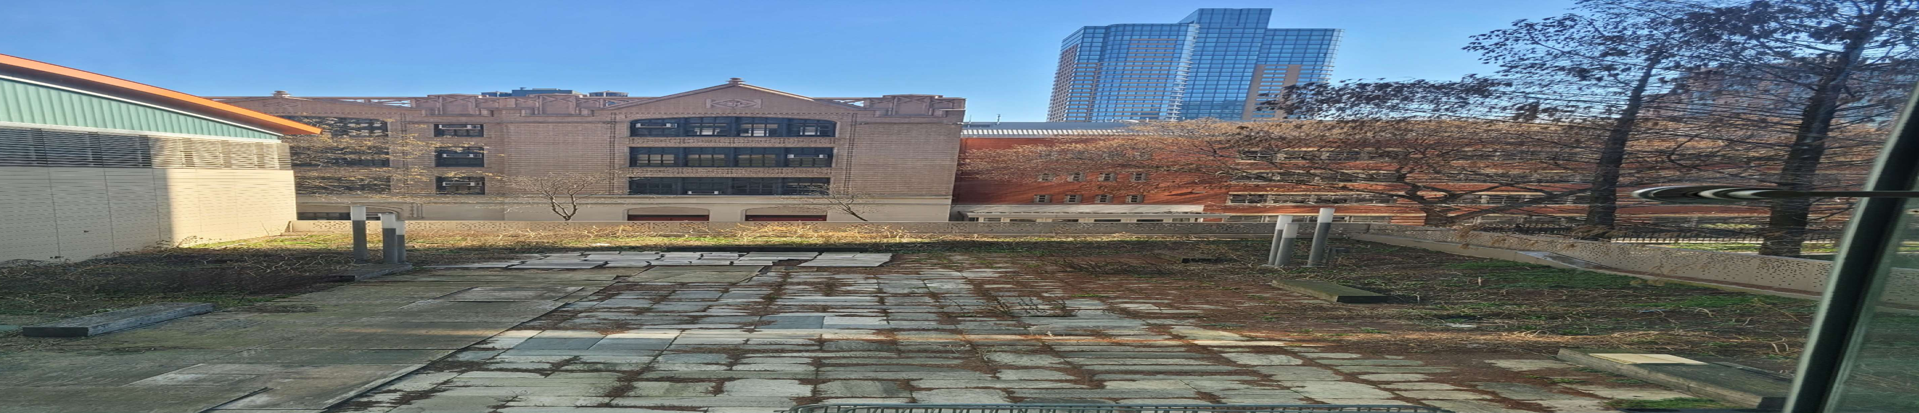

Slide 28
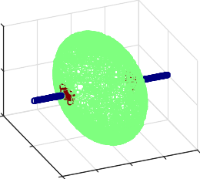
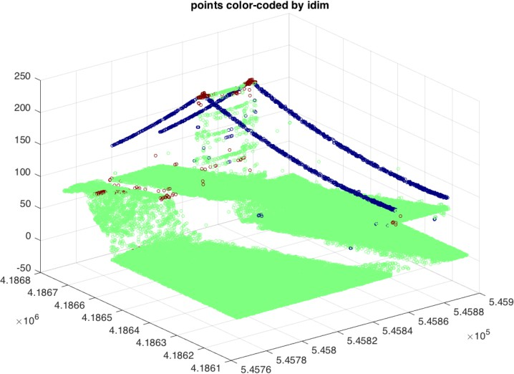
Manifold Hypothesis (related to intrinsic dimension)
Enhancing 3D Point Cloud Classification with Measure- Theoretic Features: Integrating Product Coefficients into LiDAR Analysis
points color-coded by idim
3
0.5
2.8
2.6
2.4
0
2.2
2
-0.5
0.5
1.8
1.6
0
1.4
0.5
1
1.2
-0.5
-0.5
0
1
-1
Figure: Intrinsic dimension of the line-sphere sample and the LiDAR data set from the Golden Gate bridge. Karamatou Yacoubou Djima, F. Patricia Medina, Linda Ness and Melanie Weber, Heuristic Framework for Multi-Scale Testing of the Multi-Manifold Hypothesis ,Research in Data Science, AWM Springer-Verlag Series.
Proposition (Multi-manifold Hypothesis Test)
Given a data set X = {xi}i∈I in R^{D} and a multi-manifold V , is the expected distance of the points in X to V more than one would expect? If so, reject V as being a multi-manifold that fits X.
Theoretical framework: C. FEFFERMAN, S. MITTER, AND H. NARAYANAN, Testing the manifold hypothesis, J. Amer. Math. Soc., 29 (2016), pp. 983–1049

